Slide 1
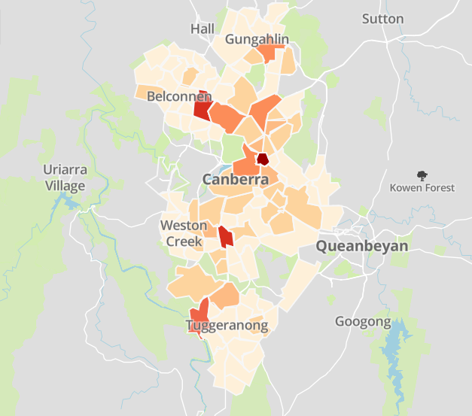

Bike rack use by suburb (total from 9 May 2016 to 23 July 2017)
Legend
 | 6092+
 | 2315 – 6091
 | 1440 – 2314
 | 736 – 1440
 | 376 – 735
 | 128 – 375
 | 1 – 127

